Slide 1

Dr. D. Y. Patil Unitech Society’s Dr. D. Y. Patil Arts, Commerce and Science College, Pimpri, Pune- 411018

Slide 2
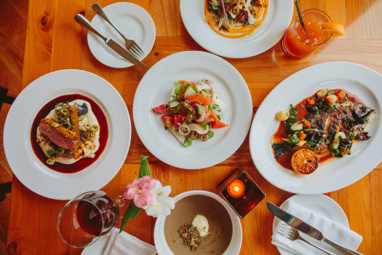
PLATES OF FLAVOURs

Slide 3
Project MEMBERS
Alex d’souza -24
Apurva jambhale-42
Pooja Kulkarni-55
GUIDE- MRS.SONALI NEMADE

Slide 4
INTRODUCTION
“Plates of Flavours”.
In our Project, we provide various types of cuisines where the user can order it. The aim of developing an Online Food Ordering system is to replace the traditional way of taking orders with a computerized system. Consumers can visit web stores from the comfort of their homes and shop as they sit in front of the computer. This project is easy, fast, and accurate. It requires less disk space For our better understanding we are going to design a static website. In this system we are using HTML5, CSS along with the Bootstrap as well as we will host the entire site through the GitHub platform.

Slide 5
H/W AND S/W REQUIREMENTS
HARDWARE REQUIREMENTS -
1)RAM-2GB
2)PROCESSOR-Intel Dual Core/i3/i5/i7…
3)HARD DISK-Minimum 4 GB
SOFTWARE REQUIREMENTS-
1)OPERATING SYSTEM-Windows XP/Windows 7/Linux/Unix
WEB TECHNOLOGIES –HTML 5,CSS
OTHER REQUIREMENTS – GITHUB,BOOTSTRAP
PLATFORM –ANY

Slide 6
EXISTING SYSTEM
IN EXISTING SYSTEM THERE ARE FOLLOWING PROBLEMS.
IN THE PRESENT SCENARIO,PEOPLE HAVE TO PHYSICALLY VISIT THE HOTELS OR RESTAURENTS FOR EATING FOOD AND HAVE TO MAKE PAYMENT through cash mode.
IN THIS METHOD TIME AS WELL AS PHYSIICAL WORK IS REQUIRED ALSO TRADITIONAL FOOD ORDERING PROCEDURE IS NOT EFFIECIENT ENOUGH FOR HOTELS AND RESTAURENTS ,AS THEY HAVE TO DEAL WITH THE CROWD IN THRIE HOTEL.

Slide 7
THE OLD METHODS CAN BE CLASSIFIED INTO CATOGORIES WHICH ARE PAPER GROUNDED AND VERBAL GROUNDED. FOR PAPER BASED WORK,THE WAITER COMES AND PENS DOWN FOODS THAT CUSTOMERS ORDER AND PASS THE FOOD LIST THEN CHEF COOKES IN THE FURTHER PROCESS.
ALSO FROM OWNERS POINT OF VIEW MAINTAING DATA RECORD AND THE ACCOUNT IN PHYSICAL FILE ARE TEDIOUS WORK TO DO.
ALSO IT IS FULL OF RISK AS ANYONE CAN ACCESS IT AND MODIFY THE DATA.

Slide 8
PROPOSED SYSTEM
THIS SYSTEM IS A BUNCH OF BENEFITS FROM VARIOUS POINT OF VIEWS. AS THIS ONLINE WEBSITE ENABLES THE END USERS TO REGISTER TO SYSTEM ONLINE,SELECT FOOD ITEM OF THEIR CHOICE FROM MENU LIST AND ORDER FOOD ONLINE.
THE PAYMENT CAN BE MADE THROUGH ONLINE MODE OR AT THE TIME OF DELIVERY DEPENDING UPON THE CUSTOMERS CHOICE AND CONVENIENCE.

Slide 9
ONE OF THE VARIOUS BENEFITS OF THIS IS SYSTEM IS THAT IS THERE IS RUSH OR HUGE CROWD PRESENT IN THE RESTAURENT THEN IN THAT CASE SOMETIMES AVAILABILITY OF TABLES CUT DOWNS THE RESTAURENTS CUSTOMER.
WITH THIS SYSTEM WORK LOAD OF WAITERS IN THE RESTAURNTS ARE REDUCED.
THIS SYSTEM ALLOW THE STAFF TO SERVE CUSTOMER WITHIN LESS TIME AS COMPARED TO THE MANUAL SYSTEM.

Slide 10


